Slide 1
The Seven Golden Rules of Investing
2020-2021

Slide 2
INVESTING IN THE FUTURE
Who We Are
Young Investors Society is an online enrichment program that teaches financial literacy through personal finance & stock market programs that emphasize long term, fundamental investing principles that emphasize the importance of saving and investing for the future. Our program is FREE to teachers & students.
Mission
Our mission is to inspire youth to be outstanding investors-investors in companies, investors in their communities, and investors in themselves.
WWW.YIS.ORG

Slide 3
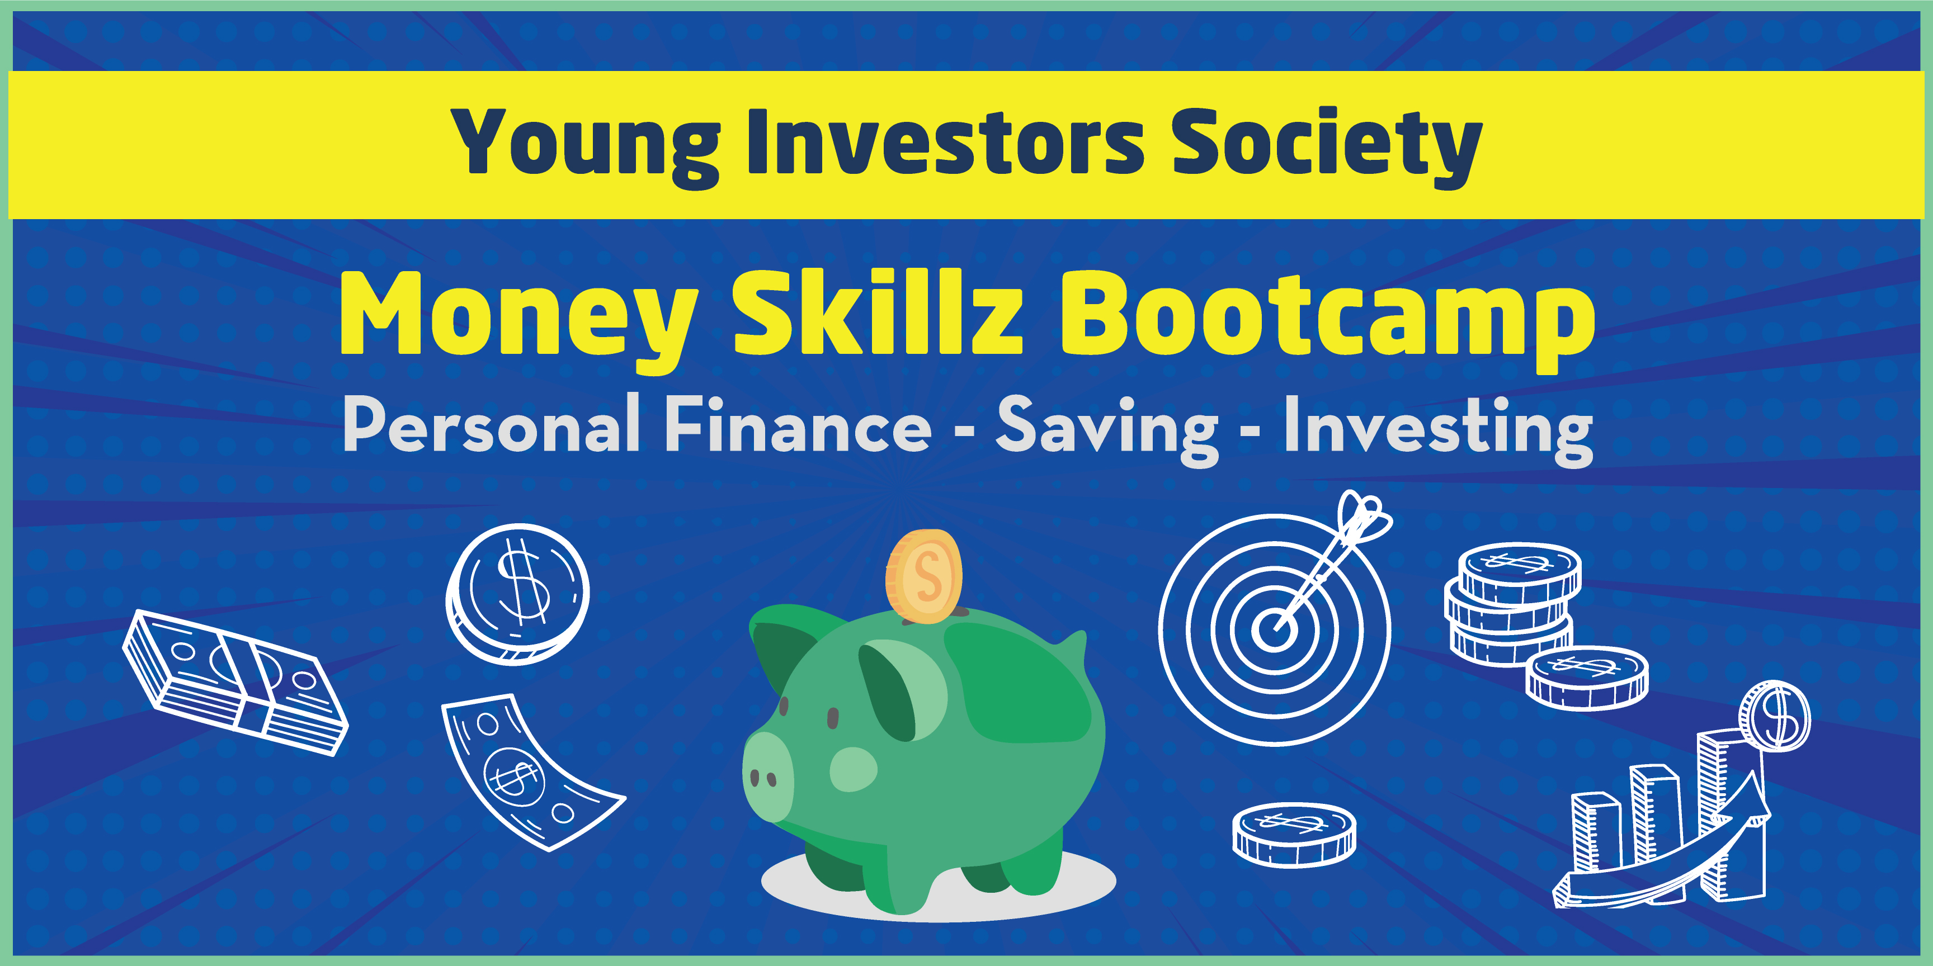
Money Skillz Bootcamp
Online Distance Learning Program
Money Skillz Bootcamp Program Overview
Young Investors Society has launched the Money Skillz Bootcamp for 7th-9th graders.
This beginner 10-hour course comprised of The Seven Golden Rules of Investing and the 5 Steps to Financial Freedom will give students a foundation in personal finance, saving, and investing that will lay the foundation for future YIS programs. Students will learn the fundamentals of earning money, saving, budgeting, banking, investing, career exploration and so much more!

Slide 4
Money Skillz Bootcamp
Seven Golden Rules of Investing
The Seven Golden Rules Intro

Slide 5
Money Skillz Bootcamp
Seven Golden Rules of Investing
Seven Golden Rules Video

Slide 6
Money Skillz Bootcamp
Seven Golden Rules of Investing
The Seven Golden Rules Overview

Slide 7
Top 5 Investment Myths
Don’t Believe the Hype
#1: Only the rich can afford to invest:
#2: You have to pick stocks to be successful:
#3: Believing you can time the market:
#4: Making investment decisions based on recent returns:
#5: Wall Street is rigged against individual investors:

Slide 8
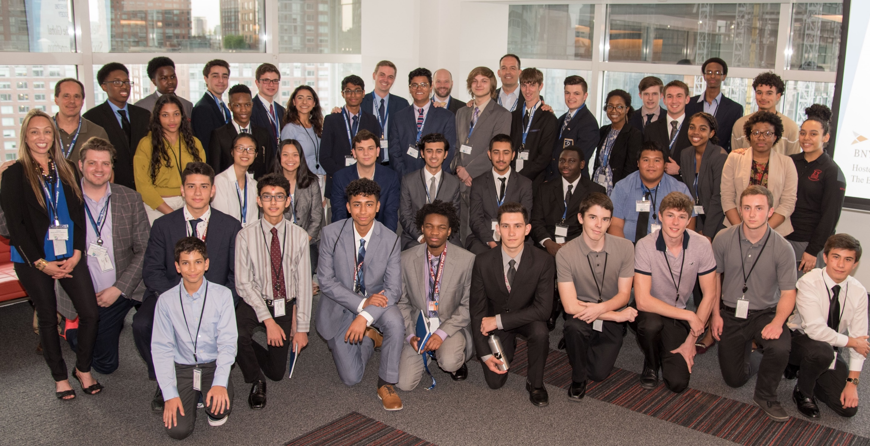
For more information about Young Investors Society
visit WWW.YIS.ORG

Slide 9
Q & A

Slide 10
Important info
Roll will be taken throughout the Summit.
You must attend three full sessions to receive a stipend.
Complete the follow up assignment at utahjumpstart.org/2020Summit to receive 0.5 USBE credit.
LAST CALL!
Confirm your address in Eventbrite. Checks may be delayed or forfeited if your address is missing.
Confirm your CACTUS number in Eventbrite.

Slide 11
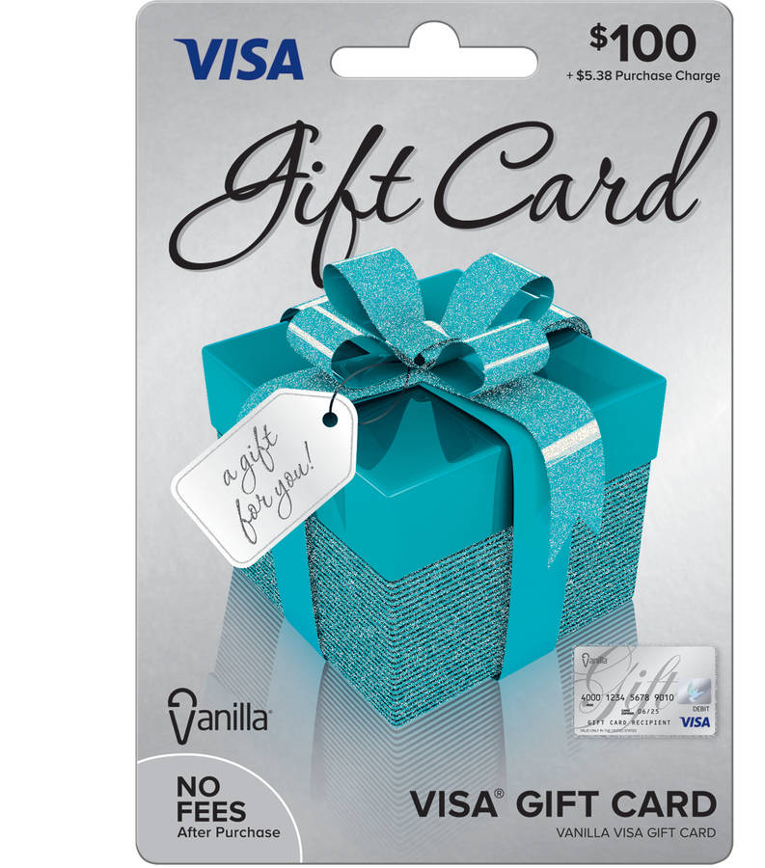
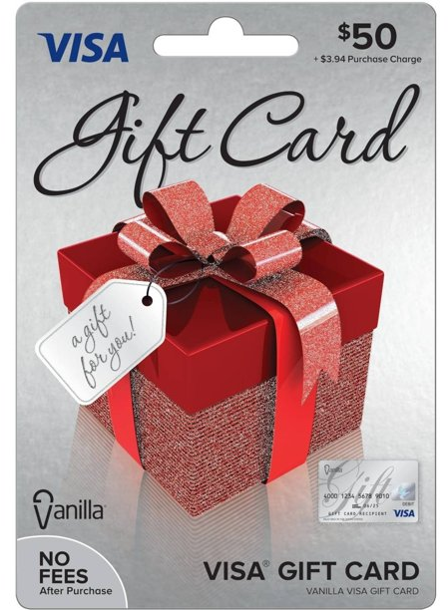
Homework
Survey
Relicensure points
Resources
utahjumpstart.org/2020Summit

Slide 13
Question of the Session
Answer to win a my529 Prize Pack!

