Slide 1
Welcome, Utah Educators!
Engage in the chat box to share any combination of the following:
Where do you teach?
What specific classes/grades do you teach?
A summer fact like:
What is your favorite restaurant you’re supporting through takeout?
What are you doing to beat the heat?
How are you staying entertained inside?
Where have you road tripped?

Slide 2
Carly Cahoon
EVERFI Implementation Manager
Salt Lake City, Utah

Slide 3
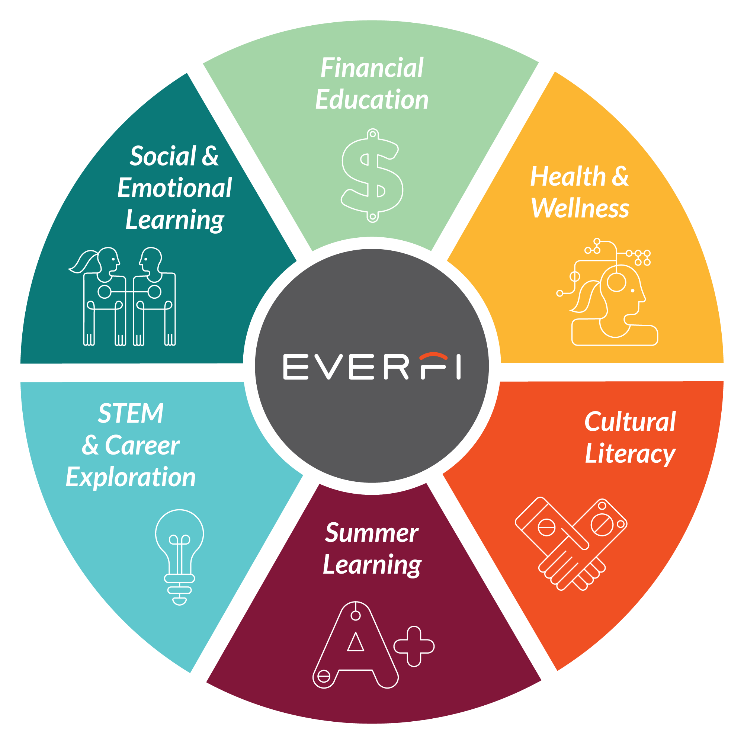
About EVERFI
With a network of 25,000+ schools and thousands of partners who share our mission, EVERFI delivers engaging digital resources, free of charge so teachers can equip students with real world skills for success beyond the classroom.

Slide 4
EVERFI
Student resources for 21st century success
Carly Cahoon
Salt Lake City, Utah

Slide 5
Instructional Resource
Overview

Slide 6
11,000 Students on The Impact of COVID-19
54% report that they feel more isolated. 51% report that they feel more stressed.
39% report that they feel more lonely.
On Mental Health
On Tech Use
38% are more concerned about their mental well-being
35% are more concerned about their amount of time they are spending online
On Academics
On Peer Connection
47% are more concerned about their readiness for the next academic year
33% are more concerned about how connected they are to their peers
Notes:
I wanted to share some data relevant to our current climate before we get into resources. 11,000 students were polled about the impact of DOVID 19 between March and May of this year. I’m sure none of this will come as a surprise to you, with half of our students expressing that they are concerned about their academics and stress leve, but it’s a nice reminder that our students need the whole-child support that you’ll be providing.

Slide 7
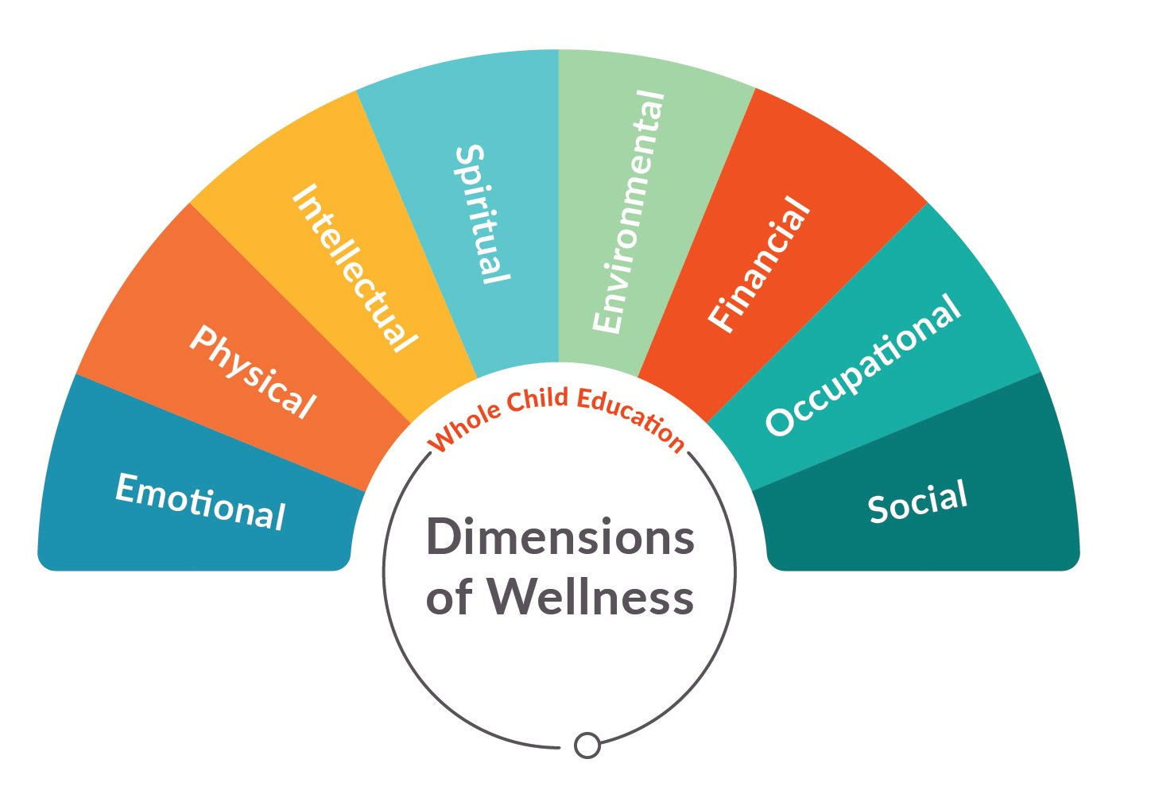
SAMHSA: The 8 Dimensions Of Wellness
SAMHSA.gov
Notes:
One of the ways that we view whole child is through SAMHSA’s 8 dimensions of wellness
US Department of Health & Human Services - Substance Abuse & Mental Health Services Administration
Initially developed by SAMHSA, this model has been utilized as a holistic representation of well-being
Each dimension of wellness can affect overall quality of life
Takes into account not just physical health, not just an expansion to mental health, but all of the areas of ones life that can impact their well-being

Slide 8
SAMHSA: The 8 Dimensions Of Wellness
Emotional
Physical
Intellectual
Spiritual
Understanding your feelings and coping with stress in healthy and effective ways
Maintaining a healthy body and seeking help when needed. Includes getting enough sleep, eating nourishing foods, exercise, and routine healthcare maintenance.
Having an open mind when you encounter new ideas and continuing to expand your knowledge. It encourages active participation in scholastic, cultural and community activities
A set of values that help you seek meaning and purpose. Spirituality can be represented in many ways, for example, through relaxation or religion.
Environmental
Financial
Occupational
Social
Living a lifestyle that is respectful of our surroundings. To live in harmony with the Earth by taking action to protect it. Environmental well-being promotes interaction with nature and your personal environment.
The overall financial health of an individual. Includes learning how to successfully manage financial expenses.
Enjoying your occupational endeavors, feeling hopeful about occupational prospects, and appreciating your contributions
Helps you perform social roles effectively and comfortably, and create a support network. Allows you to not only develop encouraging relationships with peers, but also intimate relationships with romantic partners
Notes:
-On a personal note, I enjoyed reflecting on where I stand within these 8 categories. There’s even a quiz you can take that will give you an idea of where to put in your own work
- At EVERFI, we connect with and align to SAMHSA’s 8 dimensions of wellness model, because we know that wellness is layered. By providing courses that fall into each dimension of wellness, our goal is to help students feel happier, more connected, and more confident in their ability to be ‘well’, leading to higher academic achievement as well as personal happiness.”
- We all know that whole child education is important, but it is sometimes a lofty goal when you barely have time to get through your core curriculum. My hope is that this model feels digestible, a way that you can categorize how your existing material s supporting students and maybe pick out one or two additional areas you’d like to focus on in 20-21.
-If this is something that interests you, please keep in mind how the resources you learn about today may fit into this model. We will revisit this again later on.

Slide 9
Educator Benefits
In addition to interactive digital resources aligned to your state standards, educators also receive:
Real time Reporting On Students’ Knowledge + Growth
Lesson Plans and Discussion Questions
Access to EVERFI’s Growing Library of Digital Curriculum
Student Scholarship Opportunities

Slide 10
Utah Impact 19-20

Slide 11
Financial Education | STEM & Career Exploration | Social Emotional Learning | Health & Wellness | Summer Learning | Cultural Literacy
Vault Understanding Money 4–6th Grade | Future Goals Hockey Scholar – Math Edition 4–7th Grade | The Compassion Project 2nd-4th Grade | Healthier Me Nutrition & Wellness 1st–4th Grade & 6-8th Grade | Summer Slugger Math & Literacy 4–5th Grade | 306 African–American History 9–12th Grade
FutureSmart 6–8th Grade | Future Goals Hockey Scholar – Science Edition 4–7th Grade | Ignition Digital Wellness & Safety 6–9th Grade | Mental Wellness Basics 8-10th Grade
Venture Entrepreneurial Expedition 7–10th Grade | Endeavor STEM Literacy & Career Exploration 7–9th Grade | Character Playbook Character Education 7–9th Grade | AlcoholEdu 9–12th Grade
EVERFI Financial Literacy 9–12th Grade | Keys To Your Future College & Career 9–12th Grade | Honor Code Bullying Prevention 8-10th Grade | R_{x} Drug Safety 9–12th Grade
Marketplaces Investing Basics 9–12th Grade

Slide 12
Instructional Resource
Deep Dive

Slide 13
Financial Capability
Engage in the chat box to share:
1-5, how capable are your students to set a budget and manage their income?
Why is this important?
Come off mute to share any 30-60 second personal anecdotes you share with students as you teach financial literacy!

Slide 14
Financial Capability
Notes:
Teenagers spend billions of dollars per year, so a strong foundation of financial capability is essential to developing healthy habits for life.

Slide 15
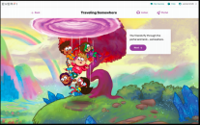
Vault
Understanding Money
*Fully updated for fall 2020
At-a-Glance
This digital financial education resource that addresses both financial concepts and social-emotional learning skills that build toward better financial health. By leveraging interactive & game-based learning, Vault immerses students in real-life financial scenarios that focus on skill-building and responsible decision making. This gamified resource features an engaging storyline, diverse cast of characters, and interactions & activities to teach students fundamental financial topics in a fun and engaging way.
Course Highlights
Embedded, performance-based games
Personalized offline goal-setting activities
Supplemental lesson plans for teachers
Course Topics
Investing, borrowing, credit vs. cash
Needs & wants, managing risks
Budgeting & savings plans
Setting financial goals
Taxes & income
Grade Level: 4th -6th
Total Lessons: 6 lessons, 30-35 minutes each
Aligns with state and national Jump$tart standards
Notes:
We’ve included a new focus on SEL. Vault lets students practice in-the-moment decision making, which correlates directly to financial health.

Slide 16
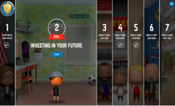
FUTURESMART
At-a-Glance
Through a compelling storyline in which students become the Mayor of a fictional town, they are faced with the real-life financial decisions and obstacles of their citizens. By helping their citizens with everything from budgeting for some bedroom decorations to guiding someone through the college financial aid process, students build important skills that help them to become FutureSmart.
Course Highlights
Simulation-based learning embedded with real-world decisions
Companion mobile app to reinforce positive financial decisions
Customizable and printable blueprint for their financial future
Course Topics
Financial values and goal-setting
Budgeting and opportunity costs
Saving and investing
Risk vs. return
Grade Level: 6th -8th
Total Lessons: 7 lessons, 20-25 minutes each
Aligns with state and national Jump$tart, NCSS
Arizona Implementation & Standards Alignment
8th Social Studies
CCR
CTE
AVID

Slide 17
A Healthy Future
Engage in the chat box to share:
1-5, how comfortable are you discussing how physical and mental health can change the trajectory of a career path?
Why is this important?

Slide 18
Health and Wellness
Notes:
Moving on to health and wellness, where we have had some great subject matter experts support the research and design of these resources to ensure they are taking a population level approach to prevention and practical skills.

Slide 19
Healthier Me
Elementary
Wellness Fundamentals
At-a-Glance
Healthy habits start early, when our eating habits and fitness routines are just forming. This course turns familiar scenarios into teachable moments to build healthy behaviors students can use throughout their lives. From building a balanced plate to identifying the activities that will improve their endurance, students will learn to become a Healthier Me.
Course Highlights
Interactive scenarios to model and reinforce healthy behaviors
Rich illustration and character animations to keep learners engaged
Real-world food and fitness choices
Course Topics
Making healthy decisions
Eating well-balanced meals
Nutritional properties of foods
Benefits of physical activity
Grade Level: 1st - 4th
Course Length: 2 lessons, 10-15 minutes each
Aligns with NHES; USDA Dietary Guidelines

Slide 20
Healthier Me
Middle School
Wellness Fundamentals
At-a-Glance
Healthy habits start early, when our eating habits and fitness routines are just forming. This course turns familiar scenarios into teachable moments to build healthy behaviors students can use throughout their lives. From building a balanced plate to making decisions at the grocery store, students will learn to become a Healthier Me.
Course Highlights
Interactive scenarios to model and reinforce healthy behaviors
Rich illustration and character animations to keep learners engaged
Real-world food and fitness choices
Course Topics
Making healthy decisions
Eating well-balanced meals
Nutritional properties of foods
Setting Health-Related Goals
Grade Level: 6th -8th
Total Lessons: 1 lesson, 25-30 minutes
Aligns with NHES; USDA Dietary Guidelines

Slide 21
Communication Skills & SEL
Engage in the chat box to share:
1-5, how important are SEL skills like identifying emotions, communicating effectively and leadership important to career success?
Why is this important?
Come off mute to share any 30-60 second personal anecdotes you share with students to help them understand why this is important!

Slide 22
Social-Emotional Learning
Notes:
Many of our social emotional learning resources are implemented right at the beginning of the year as a way to norm set in your classroom community, giving students a guide on how they should conduct themselves and treat eachother

Slide 23
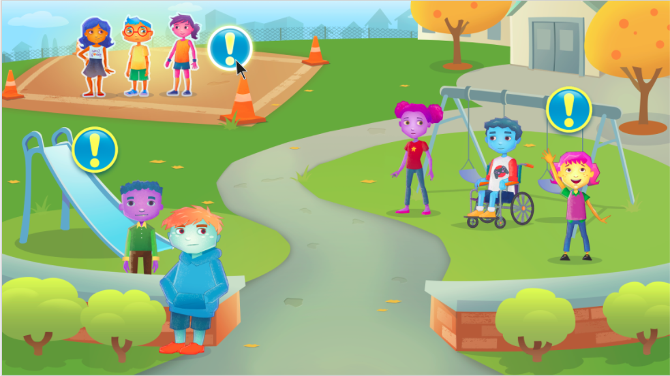
Compassion Project
At-a-Glance
Through storytelling, reflection, and rich interactive experiences, this curriculum helps to build a foundation for compassion to take root. Videos, digital activities, and classroom lessons invite students to engage with compassion in context and apply new skills, strategies, and insights to their daily lives.
Course Highlights
Short videos to model key themes and concepts
Interactive scenarios help students practice compassion
Guided classroom discussion
Course Topics
Defining compassion
Empathy and perspective taking
Mindfulness and growth mindset
Grade Level: 2nd -4th
Total Lessons: 15 lessons (3 digital), 25-30 minutes each
Aligns with CASEL SEL framework; CCSS ELA Standards
Notes:
Key Talking Points:
This is a truly blended program, containing offline lesson plans and discussion guides as well as digital exercises. As a teacher, you can implement what you have time for. It uses video, whole class discussion, and digital activities to bring concepts to life. These can be integrated in an ELA setting or in morning meetings as a way to calm and focus students for the day.

Slide 24
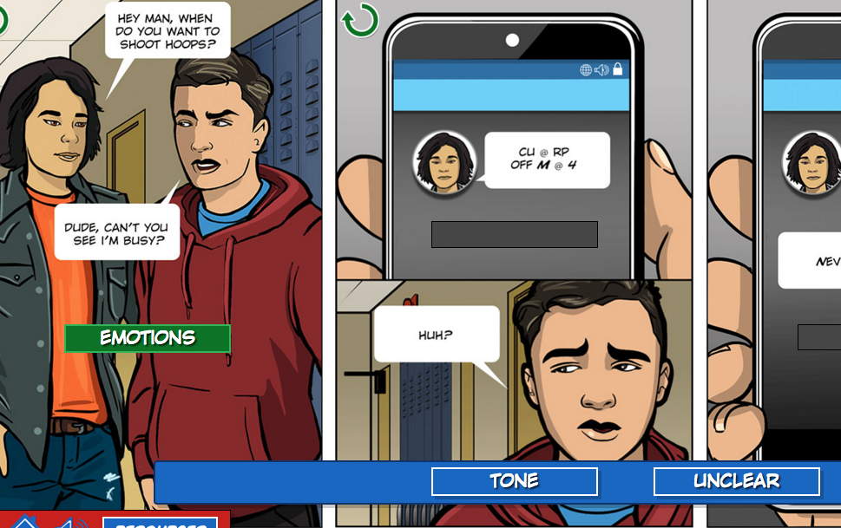
Character Playbook
Communicating Effectively
At-a-Glance
Character Playbook is an innovative digital course that uses evidence-informed strategies to educate students on core social and emotional competencies. Using true-to-life scenarios, students learn concrete strategies for managing their emotions, communicating effectively with others and making responsible and healthy decisions.
Course Highlights
Guided practice and scenario-based activities with targeted feedback
National resources for students to dive deeper in specific topics
Course Topics
Analyzing Influences
Identifying Emotions
Managing Emotions
Communicating Effectively
Resolving Conflicts
Healthy Relationships
Grade Level: 7th -9th
Total Lessons: 6 lessons, 20-25 minutes each
Aligns with NHES; CASEL SEL framework

Slide 25
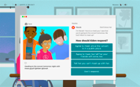
Ignition
Digital Safety & Wellness
*Fully updated in 2019
At-a-Glance
Ignition is a digital literacy and citizenship course dedicated to providing middle school students with the skills they need to safely and confidently navigate the digital world. The course helps students acknowledge the benefits of digital communities and resources while guiding them to successfully navigate potential pitfalls in their digital lives.
Course Highlights
Interaction scenarios help students practice healthy and safe behavior
“Digital Tips” help students understand key course objectives
Guided classroom discussion guides
Parent Materials
Course Topics
Digital safety and privacy
Data protection
Screen time vs. Offline time
Evaluating digital sources
Managing online connections
Online communities
Digital rights and restrictions
Grade Level: 6th -9th
Total Lessons: 6 lessons, about 30 minutes each
Aligns with CASEL SEL Framework, CCTC (Common Career Technical Core); ISTE Student Standards

Slide 26
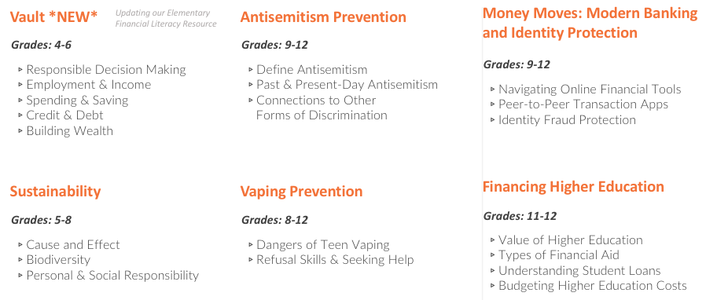
Refreshed & Up Next

Slide 27
Implementation

Slide 28
I use EVERFI resources because they put real life scenarios in an educational context. My students can learn at their own pace, and are fully engaged in the program. The units I teach are enhanced by the modules and I can monitor all their progress with a few mouse clicks.”
Eileen Lennon, New York City Public Schools

Slide 29
SAMHSA: The 8 Dimensions Of Wellness
Emotional
Physical
Intellectual
Spiritual
Understanding your feelings and coping with stress in healthy and effective ways
Maintaining a healthy body and seeking help when needed. Includes getting enough sleep, eating nourishing foods, exercise, and routine healthcare maintenance.
Having an open mind when you encounter new ideas and continuing to expand your knowledge. It encourages active participation in scholastic, cultural and community activities
A set of values that help you seek meaning and purpose. Spirituality can be represented in many ways, for example, through relaxation or religion.
Environmental
Financial
Occupational
Social
Living a lifestyle that is respectful of our surroundings. To live in harmony with the Earth by taking action to protect it. Environmental well-being promotes interaction with nature and your personal environment.
The overall financial health of an individual. Includes learning how to successfully manage financial expenses.
Enjoying your occupational endeavors , feeling hopeful about occupational prospects, and appreciating your contributions
Helps you perform social roles effectively and comfortably, and create a support network. Allows you to not only develop encouraging relationships with peers, but also intimate relationships with romantic partners
Notes:
Let’s quickly revisit the 8 dimensions, which I hope will help give you your own personal why for implementing EVERFI resources with your students

Slide 30
EVERFI & The 8 Dimensions Of Wellness
Emotional
Physical
Intellectual
Spiritual
Mental Wellness Basics The Compassion Project
Vault
Ignition Honor Code, Character Playbook, AlcoholEdu, Prescription Drug Safety
Healthier Me: ES, MS, HS Mental Wellness Basics Future Goals AlcoholEdu Prescription Drug Safety
WORD Force, Future Goals, Summer Slugger, Healthier Me: MS, Endeavor STEM, Future Smart, Venture, Mental Wellness Basics, Character Playbook, 306
The Compassion Project Mental Wellness Basics
Character Playbook Honor Code Future Smart 306
Environmental
Financial
Occupational
Social
WORD Force The Compassion Project Ignition Honor Code Mental Wellness Basics Character Playbook
Vault Future Smart Venture Keys To Your Future Marketplaces
Future Goals Endeavor STEM Future Smart Venture Keys To Your Future Marketplaces
Mental Wellness Basics The Compassion Project Ignition Honor Code Character Playbook AlcoholEdu Prescription Drug Safety 306
Notes:
I’m sure you were thinking through where some of these resources would fit as I was talking through them, and there are many ways to interpret and categorize, but this list can get us started. What dimension are you most excited to tackle in your classroom? How will you implement these resources?

Slide 31
The 8 Dimensions Of Wellness
Engage in the chat box to share:
Which dimension do you want to focus more on or emphasize this year?
Why?
SAMHSA.gov

Slide 32
Implementation Best Practices
Review lesson plans, discussion questions and vocabulary guides in the Teacher Resource Center
Determine how and when you plan to implement the modules
Reserve computers or devices as needed
Notes:
To step back a bit and start at the beginning, here are some best practices as you think through getting started
WHich resources do you want to use?
When does this fit into your curriculum? Will you use it in class? Remotely? Homework or extra credit? (automatically graded!)
Reserve devices, and make sure to print or share via PDF if using supporting resources from the resource center in addition to the self-paced student digital lessons

Slide 33
Implementation Strategies:
In class & from home
Review or Capstone Project
Introduction to New Material
Guided + Independent Practice
Flipped Classroom

Slide 34
Implementation Ideas
Money Monday + FinEd Friday: Students work on EVERFI lessons each Monday or Friday until earning certification.
Finance Coach Training: Each student, or group, is assigned a lesson. After completing the lesson, they present that lesson’s information to the class.
EVERFI: Financial Literacy for High School
Choose Your Own Adventure: Students complete at least 5 of 9 lessons over a semester, either during designated class time or at home.
Healthy Habits Homework: Assign lessons for homework, then in class discuss what new habits students would like to incorporate now and in the future based off what was learned.
Extra Credit Score: Students increase their “extra credit score.” Students earn a perfect 850 by completing all 9 lessons.
Game of Fi: Draw a game board with 9 spaces (one for each lesson). Each student moves a game piece along the board to represent the lessons they’ve completed. Give a prize for students finishing first or earning the highest score.

Slide 35
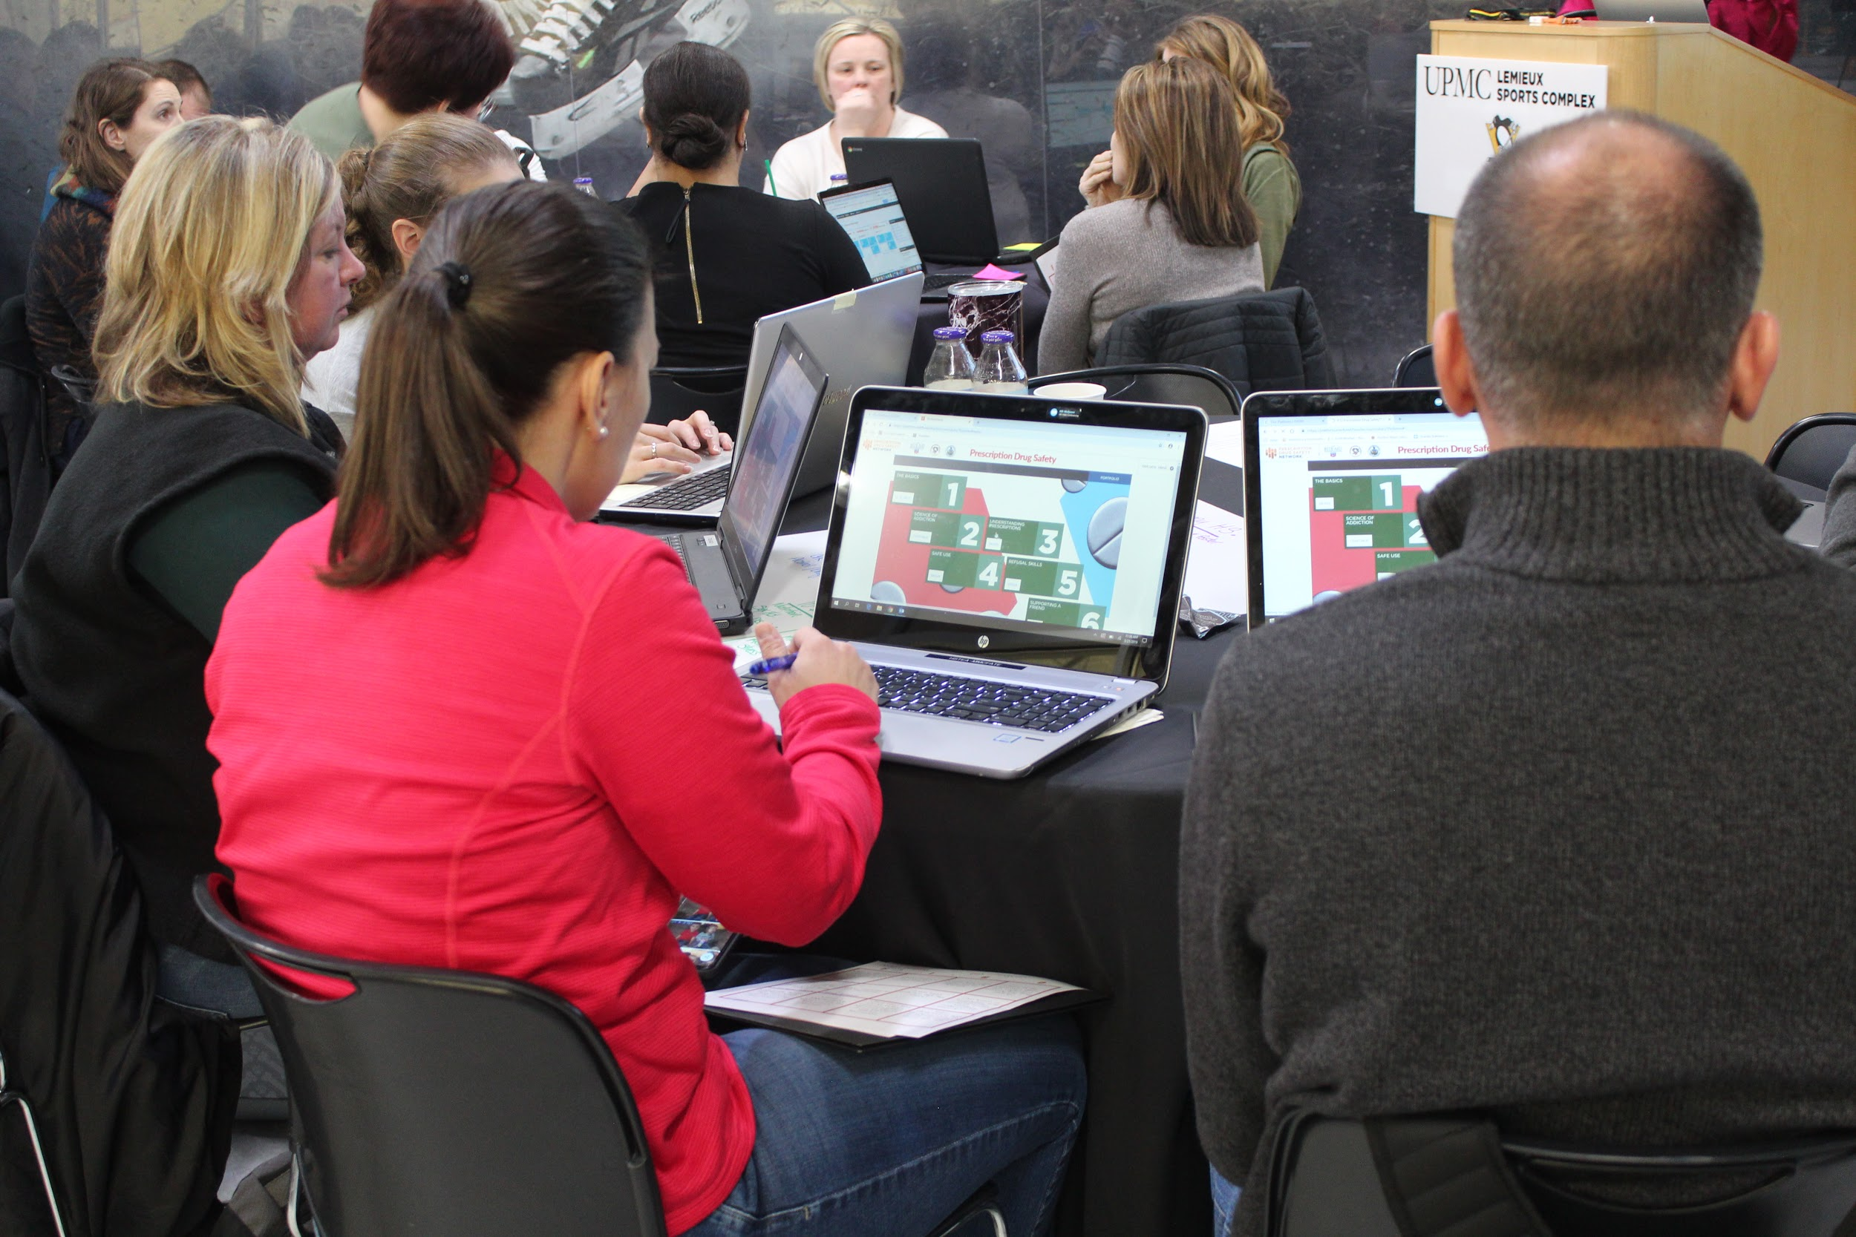
Professional Development Offerings
EVERFI offers Professional Development, Training & On-Going Support.
These sessions go beyond EVERFI resources. Attendees will walk away with skills and knowledge they can use in the classroom even if they don’t implement the digital resources.
Free to Districts and Schools
Local Implementation Manager caters content to your standards and focus areas
Addressing Critical Skill Areas:

Slide 36
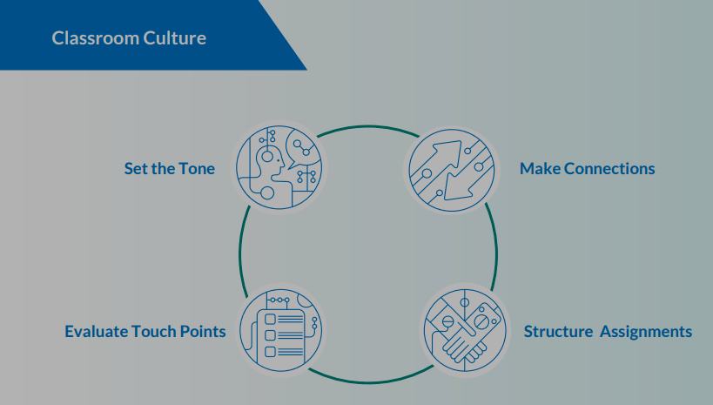
Continued Professional Learning
EVERFI helps educators reach their goals to continually learn and improve through webinars hosted by leading subject matter experts in whole child education topics.
Educators can connect with Subject Matter Experts through polls, content and Q&A.
Kickstarting a Compassionate Classroom
Details
Monthly webinars offering thought leadership and implementation practices
Upcoming Webinars:
Back to School 101 – 9.4 and 9.12
Digital Wellness & Safety – 9.24
High School Financial Education – 10.1
Attendees receive 1 hour of professional learning credit
Access past webinars on demand:
everfi.com/k12-webinars

Slide 37
Certified Teacher Program
EVERFI offers teachers a micro-credential in teaching critical skills worth 8 hours of professional development.
Participants gain a deeper understanding of EVERFI’s critical skills courses, plan for implementation within their classrooms, and become education technology advocates in their school and district.
Fall 2019
Winter 2019
Spring 2020
Application Window Opens:
August 19th – September 20th
Cohort Dates:
September 30th– December 6th
Application Window Opens:
January 6th – January 24th
Cohort Dates:
February 3rd – March 27th
Application Window Opens:
March 9th– March 27th
Cohort Dates:
April 6th – June 26th
FAQs & Application: everfi.com/certified-teacher

Slide 38
I’ve attended many PD opportunities over the years, but EVERFI’s Certified Teacher Program was one of the most effective for me. It wasn’t one day, it was ongoing. It wasn’t what they wanted to show off, it was what I needed in my classroom.”
Eileen Lennon, New York City Public Schools
BloomBoard Micro-Credentials for
Financial Education & STEM

Slide 39
EVERFI’s Teacher Ambassador Program
TAP is a collection of teachers who are passionate about education, innovators in the classroom, and thought leaders in their school communities and across North America.
Ambassador Leadership Involves:
Attending and presenting at state and national events with the EVERFI team
Guest authoring blog posts and host social media chats including #EVERFIedchat monthly
Hosting collaborative conversations and webinars with our teacher community
Assisting the Curriculum Development Team with product testing, updates and feedback
everfi.com/ambassadors
Notes:
Applications currently accepted once annually during the summer but educators can nominate themselves on the website at any time.

Slide 40
Getting Started: Educator Account

Slide 41
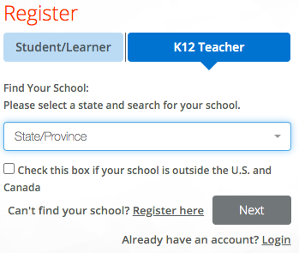
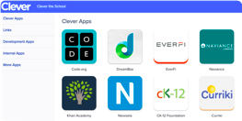
Getting Started with an Educator Account
Choose 1 of 2 options, depending on your district & position
EVERFI website
everfi.com/newteacher
2. Your district Clever page
(for rostered teachers only)
clever.com/login

Slide 42
Register- EVERFI Platform
everfi.com/newteacher
Open Google Chrome
Go to everfi.com/newteacher
Alternatively, you can go to everfi.net & click Register
State: Select from dropdown
School: Slowly type then select
Click Next

Slide 43
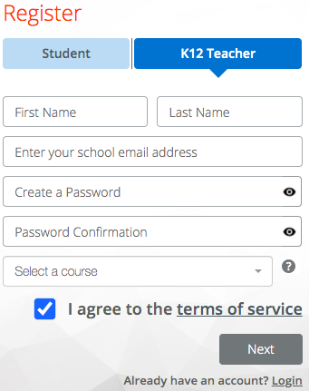
Register- EVERFI Platform
Email: Use your school email address, this will be your username
Password: Write it down
Course: Select one now, add more later
√ Agree to terms & click Next
You’re in!
Next time: Log in at everfi.com/login

Slide 44
Register- Your District Clever Platform
Open your district homepage/ auth portal/ learning dashboard
Navigate to the Clever page, usually under Academic Resources
Alternatively, you can go straight to clever.com/login
If prompted, click Log In with Active Directory
Click the EVERFI app
You’re in!

Slide 45
General Navigation Tips: The Blues
Dark Blue: Home, Catalog, Support
Light Blue: Courses, Classes, Students, Reports
White line indicates the page you’re on
Feel lost? Click Home

Slide 46
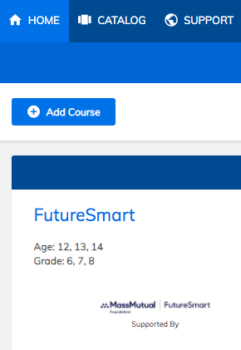
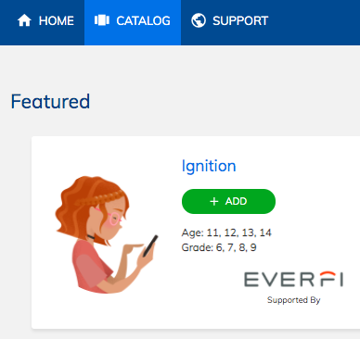
Explore the Catalog
Click Catalog
Explore content & suggested grade level
Click Add to move the resource from Catalog to Home Click
Done? Click Home and scroll down to ensure all resources are listed
Notes:
Grade level is only a suggestion, generally based on national reading level and content maturity

Slide 47
Recapping what we’ve done so far
Open Google Chrome
Go to everfi.com/newteacher
Select your state then start slowly typing your school name to select
Username must be your school email, password is your choice
Select one resource then click Next to enter your EVERFI Home page
You’re in! Click Catalog
Review resources & click Add on all you’re interested in using
Click Home to get back to the home screen
All resources you’re interested in should be listed when you scroll down

Slide 48
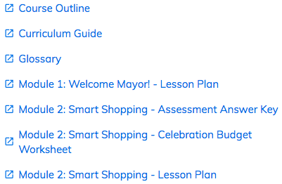
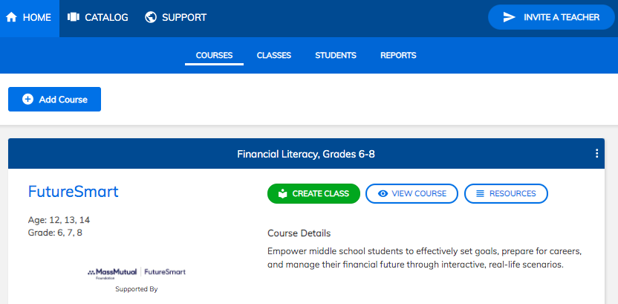
View Teacher-Only Resources

Slide 49
Demo Digital Lessons from the Student View

Slide 50
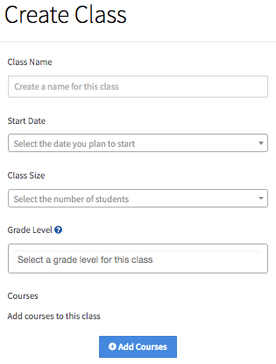
Create Classes
Click Classes
Click Create Class
Fill out the form
Click Add Courses

Slide 51
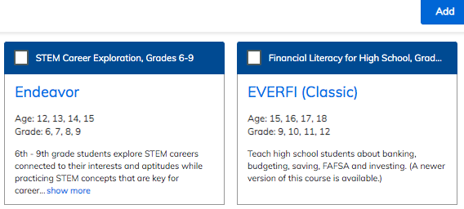
Create Classes
5. Check the boxes next to all courses
6. Click Add

Slide 52
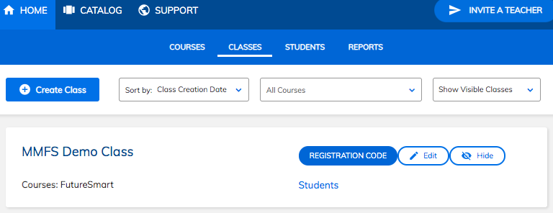
Create Classes
Find all classes you’ve set up this year under Classes
Find code for student self-registration by clicking Registration Code
If using Clever, no code is needed

Slide 53
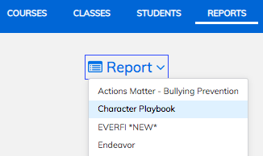
View Student Progress/Reports
Click Reports
Click the dropdown to select course

Slide 54
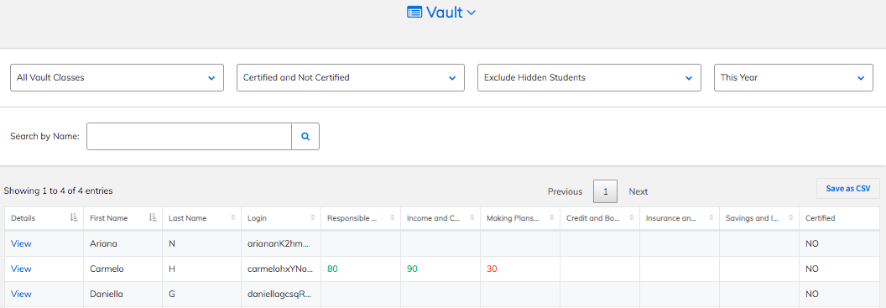
View Student Progress/Reports

Slide 55
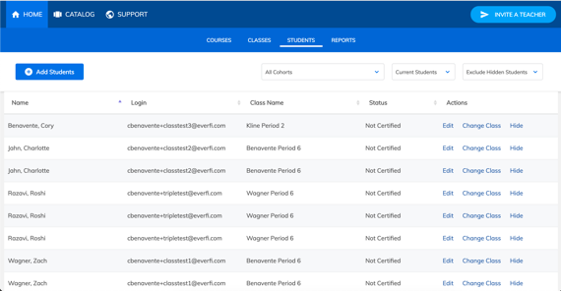
Student Profiles

Slide 56
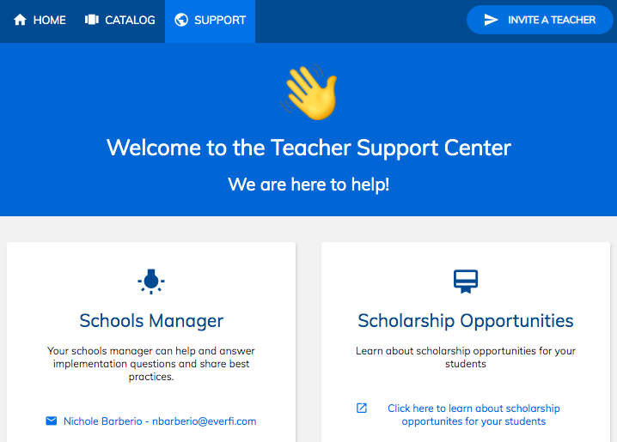
Support

Slide 57
Getting Started: Student Account

Slide 58
Getting Students Started
1 of 2 options, depending on your district
EVERFI website
everfi.com/newteacher
Your district Clever page
clever.com/login

Slide 59
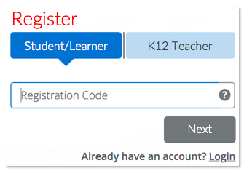
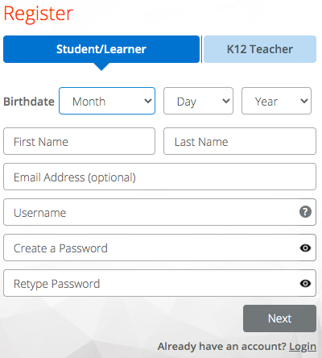
Student Registration with Code
everfi.com/register
Enter code & click Next
Birthday
Not stored, just √ over or under 13
Name
Username
Must be unique, letters & numbers
Suggest: ID# + initials or computer username
Password
All student passwords can be the same
Suggest: school mascot + graduating year or computer password

Slide 60
Student Access- Your District Clever Platform
Open your district homepage/auth portal
Navigate to the Clever page, usually under Academic Resources
Or clever.com/login
Click the EVERFI app
All resources chosen by the teacher are there!

Slide 61
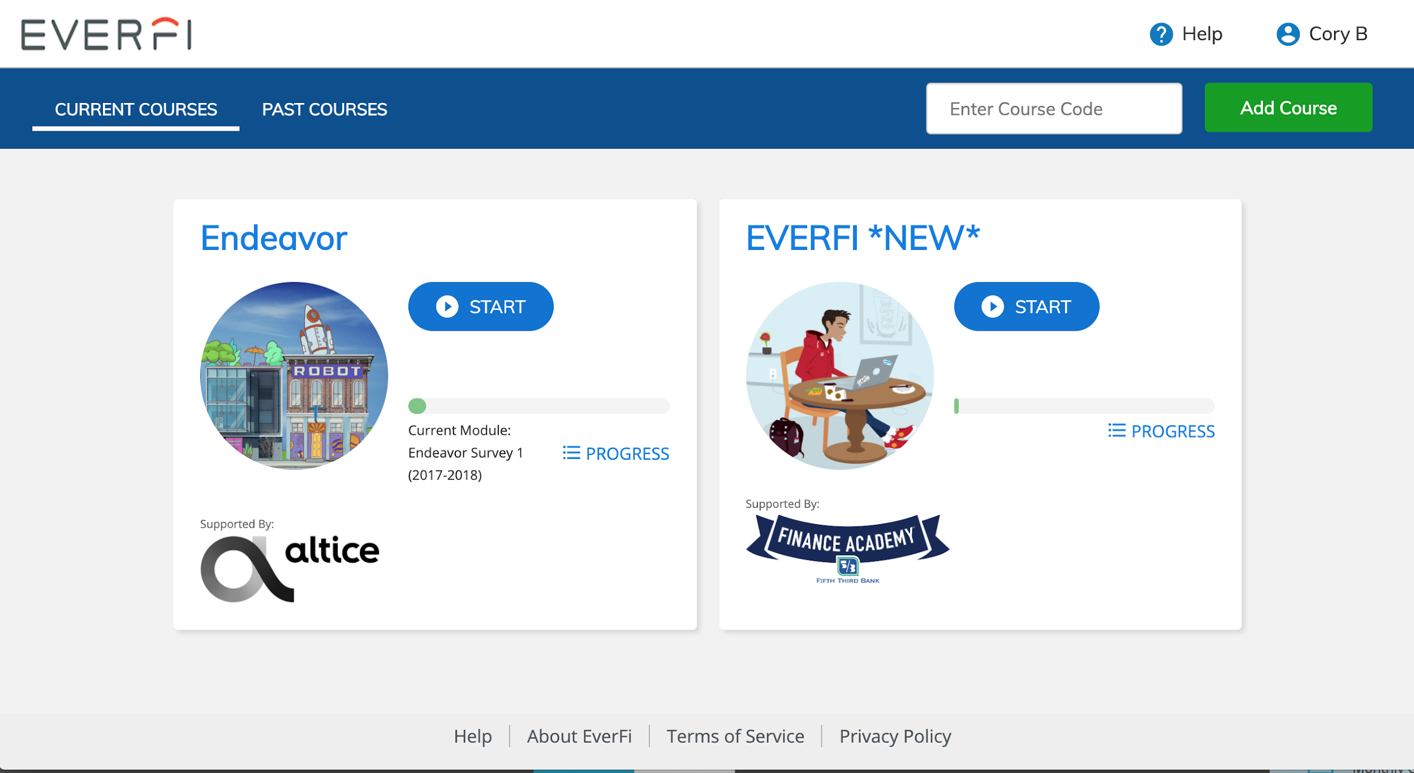
Student Dashboard

Slide 62
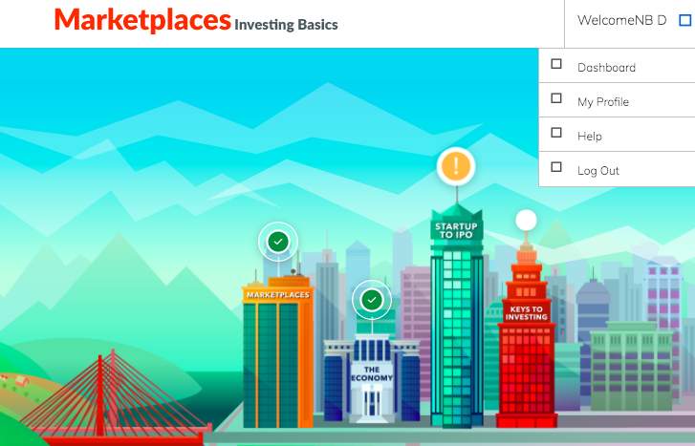
Student Experience

Slide 63
Next Steps
Click Classes to view what you’ve set up this year or create new ones
If a class is missing click Create Class, fill out the form & click Add Courses
If a class needs to be edited, click Edit
If you’re ready to get students started, click Registration Code

