Slide 1
2020 Utah Jump$tart Teacher Conference – Everything you wanted to know about income taxes
August 3, 2020

Slide 2
Where do my Federal income taxes go?

Slide 3
Why file my income taxes?
It’s the law
There’s no time limit to collect taxes
To receive your refund if you qualify
To protect your social security benefits
To receive your economic impact payment if you qualify (we’ll discuss more in a minute)

Slide 4
What do I need to understand about paid preparers?
What kind of tax preparer do I need?
Anyone can be a paid tax return preparer as long as they have an IRS Preparer Tax Identification Number (PTIN). However, tax return preparers have differing levels of skills, education and expertise.
Directory of Federal Tax Return Preparers:
https://irs.treasury.gov/rpo/rpo.jsf

Slide 5
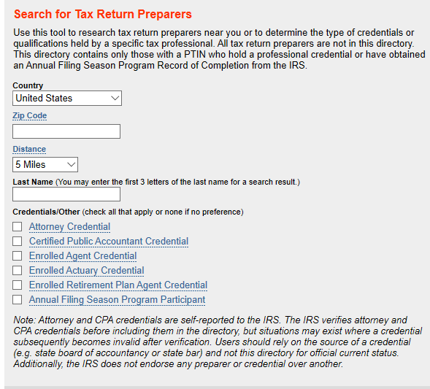
How can I check a tax preparer's credentials?

Slide 6
Department of Professional Licensing:
Look up a license: https://secure.utah.gov/llv/search/index.html
Utah Division of Occupational and Professional Licensing
Licensee Lookup & Verification System
Information Current as of 07/16/2020
Search by:
Name and Profession
License Number
Name Search:
Search results BEGINNING with "name" (Examples: "Mary Smith" or "M Smith" or "Smith")
Search results CONTAINING "name" (wild card search)
Narrow my search by profession:
ACCOUNTANCY

Slide 7
2020 Economic Impact Payment
Who is eligible?
How much will I receive?
What if I haven’t received my payment?
Provide Direct Deposit Information
Use "Get My Payment" to enter your bank account information to get your payment through direct deposit.
https://sa.www4.irs.gov/irfof-wmsp/notice

Slide 8
https://sa.www4.irs.gov/irfof-wmsp/login
Get My Payment
If you need additional help, please visit our Frequently Asked Questions page.
All fields marked with an * (asterisk) are required.
Social Security Number (SSN) or Individual Tax ID Number (ITIN) *
Date of Birth *MM/DD/YYYY
Street Address *
ZIP or Postal Code (* Required except for countries without ZIP or postal codes)

Slide 9
Where do my State income taxes go?
The short answer: All state income tax dollars fund education

Slide 10
Utah State tax reform – where are we?
“Tax modernization is still needed in order to have sustainable funding for public education, Medicaid, and other critical, core government services.” – Governor Herbert 2020 state of the state address.

Slide 11
What do minors need to know about taxes?
For 2019 has earned income above $12,200
The minor has self-employment income above $400
The minor has Federal or state income tax withheld from their check and the qualify for a refund.
The minor has unearned income above $1,100
The minor wants to open an IRA
The educational experience

Slide 12
IRS Teacher Resources:
https://apps.irs.gov/app/understandingTaxes/teacher/hows.jsp
Does teaching about taxes seem as intimidating as completing your yearly tax forms? Don't worry! Understanding Taxes can be customized to fit your own personal teaching style. There are 14 modules in the Hows of Taxes. Each module focuses on a different set of tax concepts and includes interactive activities, tutorials, simulations, and assessments. Detailed lesson plans are included to guide your instruction from the introduction of a given tax concept, through its development, to the lesson conclusion.

Slide 13
Does teaching about taxes seem as intimidating as completing your yearly tax forms? Don't worry! Understanding Taxes can be customized to fit your own personal teaching style. You have the freedom to choose which activities and methods of instruction work best to meet the needs of your students. Teaching taxes can take a traditional approach as students complete downloaded worksheets, classroom activities, and assessment pages. Or, students can complete work online and take part in interactive activities and simulations. what's here: Custom Resource ListLooking for a way to customize Understanding Taxes to meet your specific classroom needs? Try creating a Custom Resource List that allows you to save lesson plans and their links for later online access. Lesson PlansUnderstanding Taxes offers 38 lesson plans. Detailed lesson plans guide your instruction from the introduction of a given tax concept, through its development, to the lesson conclusion. Each lesson plan serves as an instructional guide on how to incorporate tax theory, history, and application into your classroom. This also gives you the freedom to choose lesson content and activities to use in the classroom. Educational StandardsHow does Understanding Taxes support instruction in the classroom? There are links to state and national standards in each lesson. DownloadsEach lesson includes downloadable components which can be downloaded individually or as a complete lesson pack. Downloads are in PDF format, with the exception of a series of PowerPoint™ presentations. Tax Forms for Classroom Use Order tax forms free from the IRS for your classroom. | Confused about tax terms and forms? Interested in learning more about the basic concepts behind taxes? Understanding Taxes can take the mystery out of taxes. The Hows of Taxes includes 14 self-paced modules, offering a step-by-step approach to tax preparation. Investigate the theory and history behind America's tax system. Who were the key players instrumental in the development of this system? What is the rationale supporting existing and past tax legislation? How can you affect your tax situation? Whatever your interest, there's something for everyone in the 24 student lessons.

Slide 14
The Whys of Taxes:
https://apps.irs.gov/app/understandingTaxes/teacher/whys.jsp
The Whys of Taxes examines the theory and history of taxes. The Whys of Taxes includes six tax-related themes, divided into a total of 25 lessons. Each theme examines a different set of tax concepts, and includes a variety of interactive activities and assessments. The first lesson of each theme contains a PowerPoint™ presentation providing a pictorial overview of the entire theme.

Slide 15
Contact info: Susan Speirs, CPA
ss@uacpa.org
801-834-6635

Slide 16
Important info
Roll will be taken throughout the Summit.
You must attend three full sessions to receive a stipend.
Complete the follow up assignment at utahjumpstart.org/2020Summit to receive 0.5 USBE credit.
LAST CALL!
Confirm your address in Eventbrite. Checks may be delayed or forfeited if your address is missing.
Confirm your CACTUS number in Eventbrite.

Slide 17
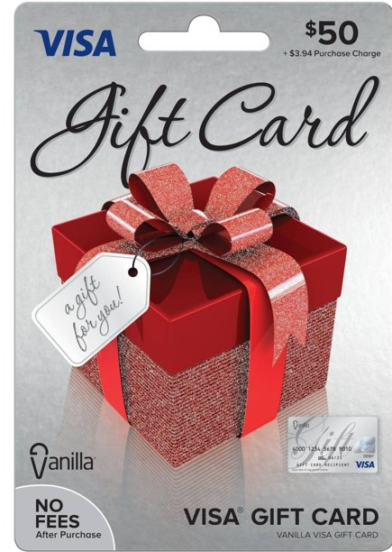
Homework
Survey
Relicensure points
Resources
utahjumpstart.org/2020Summit

Slide 19
Question of the Session
Answer to win a my529 Prize Pack!

